Slide 1


SMART GARDEN
GANESH AND TEAM

Slide 2


TABLE OF CONTEXT
Abstract
Introduction
Problem Statement
Architecture Design
Modules
Reference
TEAM MEMBERS
PRANEETH(0678)
GANESH(0691)
AALAP(0690)
NAVIN BALAJI(0683)
SUDESHA(0668)

Slide 3

Abstract
A smart garden refers to a system that uses technology to manage and monitor various aspects of gardening. This includes the use of sensors, internet of things (IoT) devices, and automation to optimize plant growth and health while reducing human effort. Smart gardens typically involve the use of a mobile application or web-based dashboard that allows gardeners to remotely monitor and control their plants. Some features of a smart garden may include automated watering and fertilizing, real-time monitoring of temperature, humidity, and lighting conditions, and recommendations for plant care based on environmental factors. With the increasing popularity of indoor and urban gardening, smart gardens have become a popular solution for those seeking an efficient and low-maintenance way to grow plants in a variety of settings.

Slide 4
Introduction
Gardening is a popular hobby enjoyed by millions of people worldwide. However, traditional gardening can be time-consuming, labor-intensive, and challenging, especially for those who live in urban areas with limited space. Smart gardening offers a solution to these challenges by integrating technology to create a more efficient and automated approach to gardening. With smart gardens, individuals can grow plants and vegetables with ease, without the need for extensive gardening knowledge or time commitment. In this modern age, smart gardens are increasingly becoming popular due to their ability to optimize plant growth, save water, and reduce wastage while requiring minimal human intervention.

Slide 5
Problem Statement
While gardening is a popular and enjoyable activity, it can also be challenging and time-consuming, especially for those with busy lifestyles or limited space. Traditional gardening methods often require a significant amount of effort, including regular watering, fertilizing, and monitoring of plant health. Furthermore, environmental factors such as temperature, humidity, and lighting conditions can greatly impact plant growth and health. These challenges can discourage individuals from pursuing gardening as a hobby or prevent them from achieving optimal results.

Slide 6
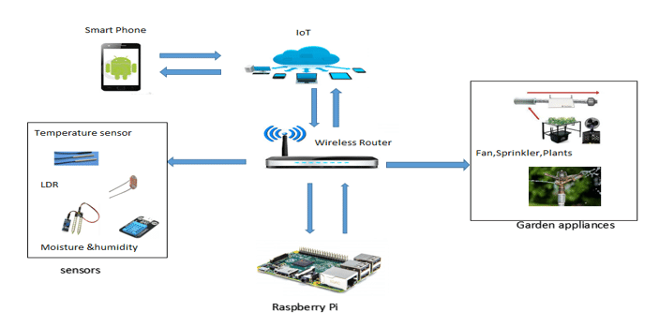
Architecture Diagram

Slide 7
Modules
Sensor module: This module includes sensors that can detect environmental factors such as temperature, humidity, and lighting conditions. The sensors send data to the central system, which can analyze the information and adjust settings accordingly.
Watering module: This module includes a system that automatically waters plants when the soil moisture levels drop below a certain threshold. This module can be connected to a water source and can be set up to water plants at specific times or intervals.
Control module: This module includes a mobile application or web-based dashboard that allows users to monitor and control their smart garden. Users can adjust settings, receive alerts, and view data on plant growth and health.

Slide 8


